Slide 1
Under Light Load (RL Load)

Slide 2
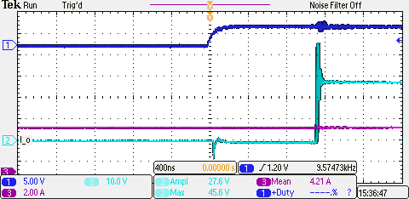
DRAIN SOURCE VOLTAGE Under Light Load (Passive Probes)
Driver Input Signal
18V
Vds = 27V
4.2A

Slide 3
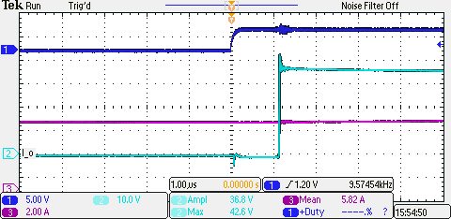
DRAIN SOURCE VOLTAGE Under Light Load (Differential Probes)
Driver Input Signal
5V
Vds = 37V
5.8A

Slide 4
DRAIN SOURCE VOLTAGE Under Light Load (Differential Probes)
8V
Vds = 37V
Ids = 10A

